Slide 1
Tasdiq Dewan IMS Project

Slide 2
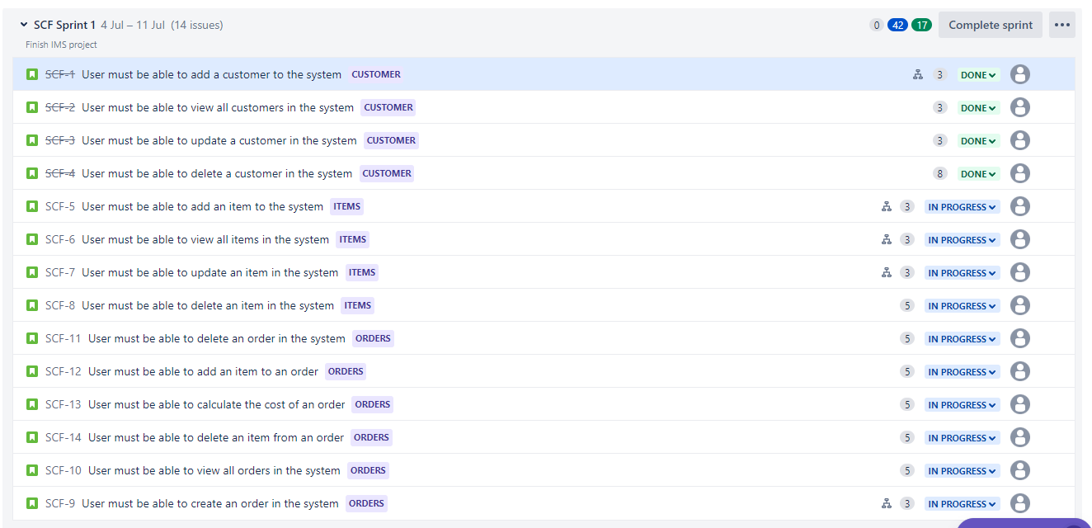
Jira

Slide 3
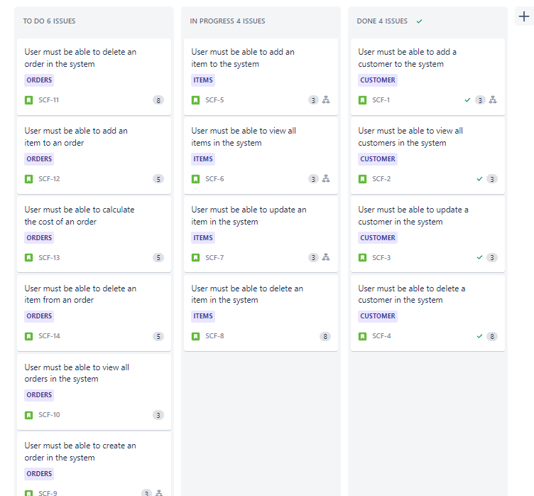
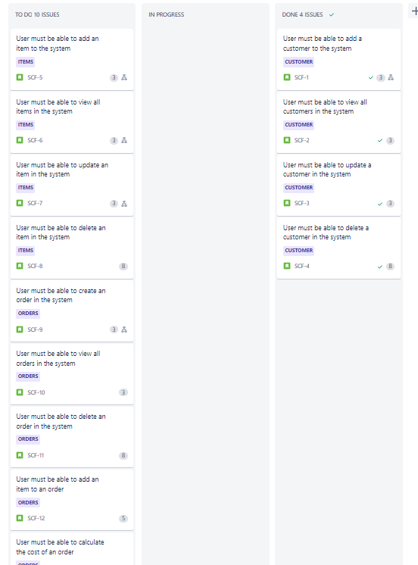
Jira

Slide 4
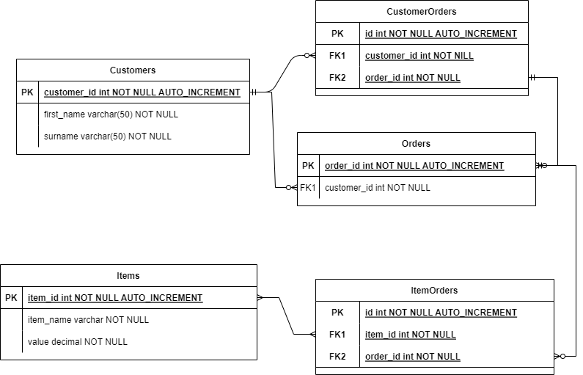
Entity Relationship Diagram

Slide 5
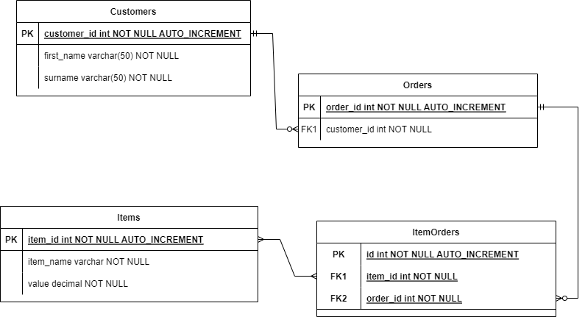
Entity Relationship Diagrama

Slide 6
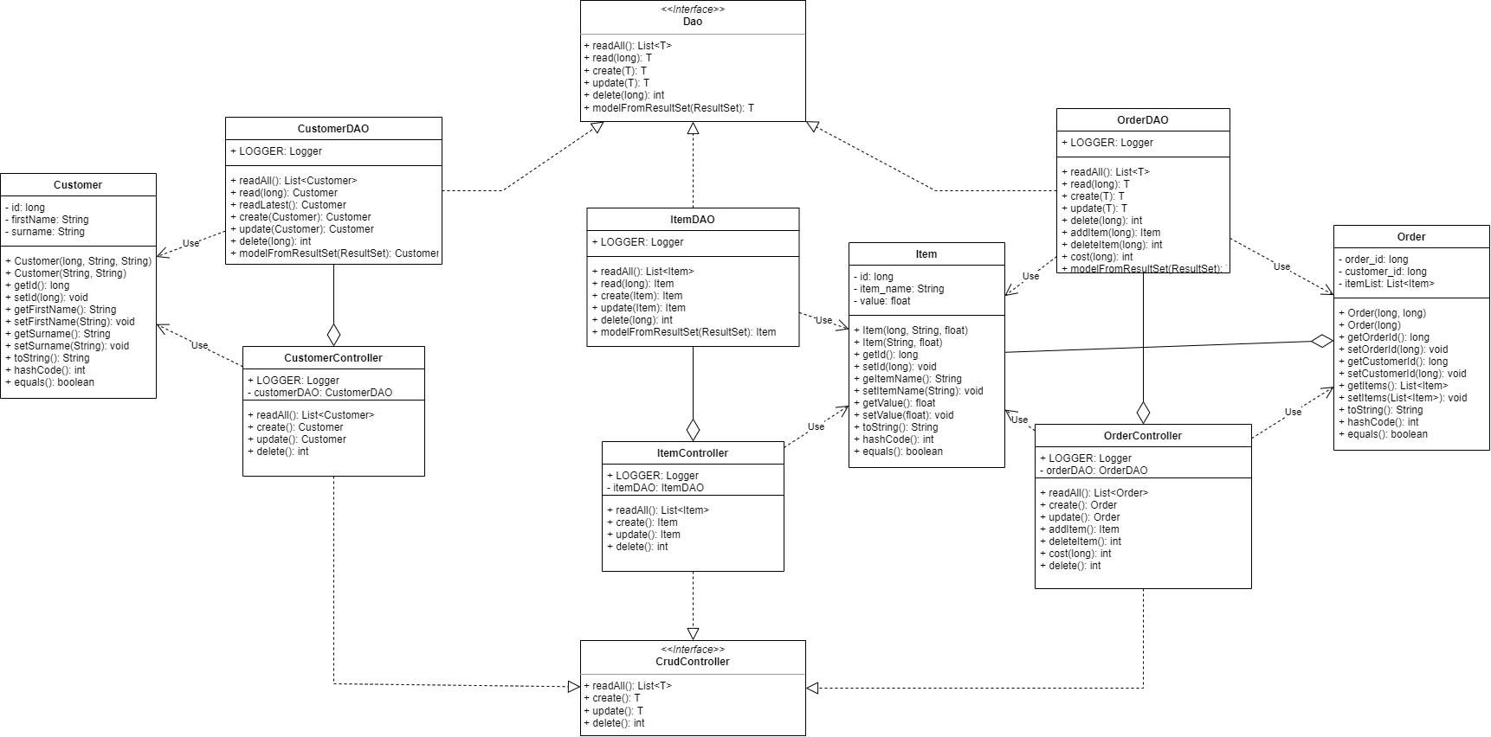
UML Class Diagram

